Slide 1


Security Principle 3: Network Security
Securing out Networks

Slide 2
What is Network Security?
Network Security: protection of computer networks from internal and external cyberattacks.
It is to ensure communications and operations within a network can operate as usual and avoid disturbance from any attacks.

Slide 3
Why does Network Security matter?
Network security matters because of its main aims:
  prevent unauthorised access to resources
  detect and stop cyberattacks
  ensure authorised users have the access they should have.
New technologies such as Artificial Intelligence and Internet of Things are entering our daily lives. As new technologies continue to develop and influence our lives, the size of the attack surface hackers can exploit increases (IBM, 2021).
Let's see what happens when Network Security fails in Ubuntu and AWS, and how to fix it.

Slide 4

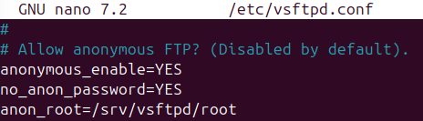
Initial Linux Vulnerable Setup
Figure 1: Installation of vsftpd
Installing vsftpd – vsftpd is a File Transfer Protocol (FTP) server, which is used for downloading files between computers.
Vsftpd looks for the file path /etc/vsftpd.conf which configures the behaviour of vsftpd (vsftpd.beasts.org, n.d.).
The main focus of the vstfpd.conf is:
  anonymous_enable=YES – allows anonymous access to the FTP server. Makes it impossible to identify who has accessed it and what activities were performed. Not knowing any information about the attacker makes things more unpredictable to know how/when they’ll return for another attack.
Firewall was disabled, therefore there’s no tool to protect against unauthorised use and identify malicious behaviour, which would provide a great layer of security,
Figure 2: Settings of vsftpd within /etc/vsftpd.conf
Figure 3: Firewall Disabled

Slide 5
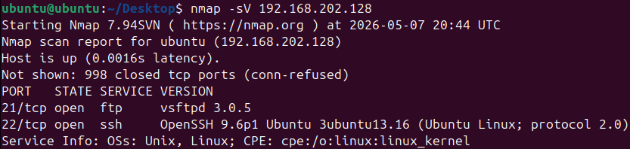
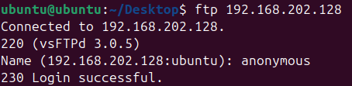
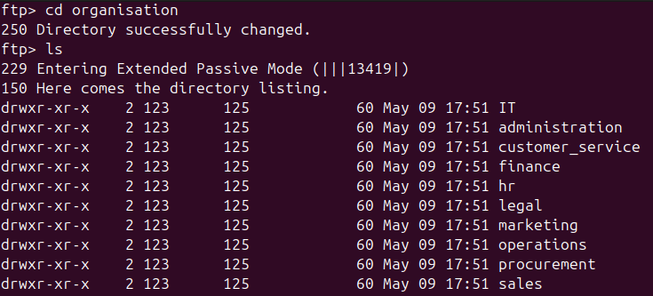
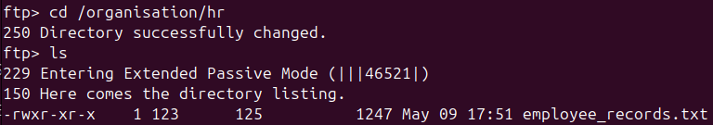
Linux Exploitation Process
Figure 4: nmap scanning for open ports
Nmap is an open-source tool for network scanning & exploration. In this case, it was used to identify the vsftpd server on Port 21.
It managed to do this because there is no firewall, meaning the port is left open to the public. Without a firewall, anyone can access the FTP server and view what files and contents are stored by the organisation.
In Figure 5, after trying to enter the FTP server by entering “ftp {IP address}”, the attacker enters the username “anonymous”. They have now entered the server very easily without any identification of their identity.
In Figure 6, the attacker can view the list of folders that belong to the organisation. He then found a file named employee_records.txt inside the HR folder.
This discovery reveals the organisation’s file structure, which an attacker can use for future attacks.
Figure 5: Successful anonymous access to FTP server
Figure 6: Attacker obtains file paths and name of files in HR folder

Slide 6
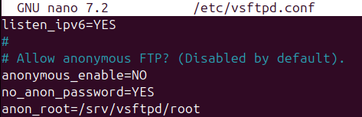
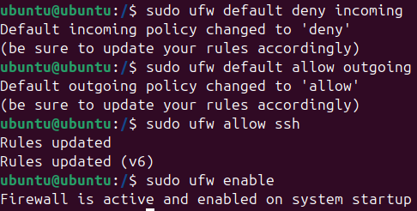
Solutions for preventing exploitation: Enforcing access control policies in Ubuntu
Changed anonymous_enable to No, which prevents them from having unauthorised access to the FTP port ever again.
Setting up the firewall in Ubuntu OS (Boucheron, Camisso and Abid, 2024):
  sudo ufw default deny incoming – sets rule to block all incoming traffic
  sudo ufw default deny outgoing – sets rule to allow outgoing traffic
  sudo ufw enable – enables firewall, meaning malicious activity can be detected, and a security layer within the organisation’s system is implemented.
Figure 7: anonymous_enable is now set to NO in vsftpd.conf
Figure 8: Enabling the firewall

Slide 7
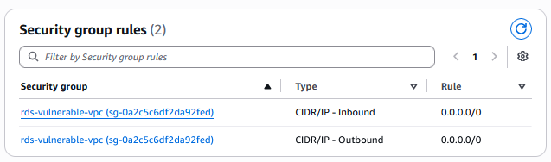
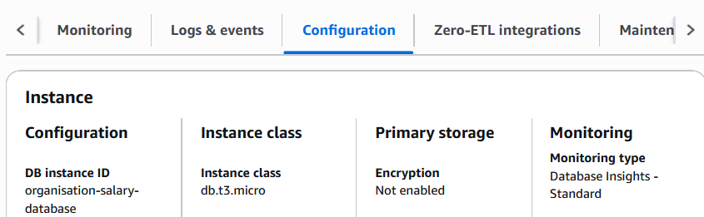
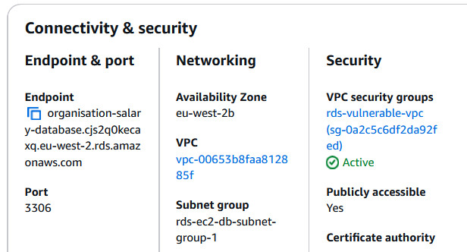
Initial AWS Vulnerable Setup
Amazon Relational Database Service (RDS) is a web service where AWS users can set up, operate and scale a relational database.
The organisation in this simulation has chosen to set up its own for the 1st time and is currently evaluating what to store in them. However, they have made a few tricky errors.
Figure 9 – The port the database operates on is port 3306 and is currently open to 0.0.0.0/0. This allows any inbound Hypertext Transfer Protocol access from any IP address (Amazon.com, 2019). Allowing any sort of incoming traffic means there is no database restriction implemented to limit attempts to connect to it.
Figure 10 – There is no encryption enabled. Encryption protects data by scrambling it into a form that is only readable with a special key. If an attacker bypasses security, he can’t understand the data without the key. This benefit, however, isn’t playing out at the moment.
Figure 11 – Public Access is “Yes”. This would expose sensitive data that the organisation would implement to anyone on the internet.
Figure 9: Any inbound traffic is allowed due to the 0.0.0.0 rule
Figure 10: Encryption not being enabled
Figure 10: Encryption not being enabled

Slide 8
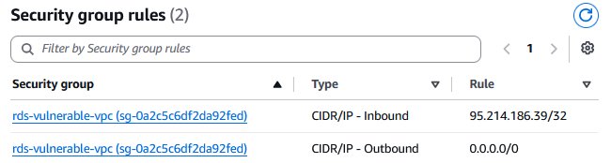
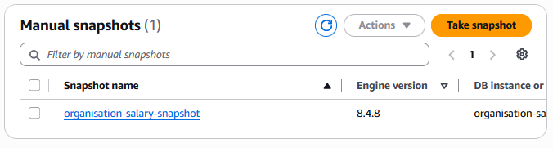
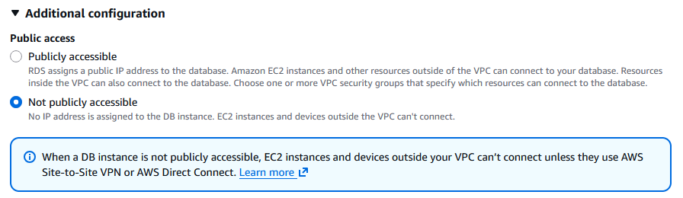
Solutions to fix the AWS vulnerabilities
Figure 12: Inbound traffic is now limited to authorised users
Restriction of Port 3306 – allow only employees of the organisation to be the inbound traffic to their organisation’s database to connect to it, so attackers can’t try to access database.
Encryption via a snapshot – Create a snapshot in the “Snapshots” section of RDS and then copy it to enable Encryption.
  The final step is to restore the RDS instance from the encrypted snapshot to get an encrypted copy of the original database instance (Amazon.com, 2026).
  This wasn’t performed as AWS does charge you for this. (I had to learn this the very hard way, left the instance on and paid £900+)
  This is because I didn’t shut the RDS down; make sure you shut it down when not used to save money.
Disabled Public Accessibility – Change it from a Yes to a No. Makes the RDS private within the organisation’s AWS server itself and isolates it from the public internet.
Figure 13: Adding encrypted snapshot
Figure 14: Reversing the implementation of public access of the relational database

Slide 9
Summary
Network security is the protection of computer networks from internal and external cyberattacks
Its aims are to prevent unauthorised access to resources, detect and stop cyberattacks and ensure authorised users have the access they should have.
In both Ubuntu and AWS, we discovered what happens when there are no inbound restrictions to access a network. It allows public users to access confidential data they shouldn’t have.
Data of your own business must be kept private from the rest of the public, else negative consequences can occur, such as data modification and data leaks.
To prevent this, implement firewalls and inbound restrictions that only allow authorised users to connect to your and their resources.

Slide 10
References
IBM (2021). Network security. [online] Ibm.com. Available at: https://www.ibm.com/think/topics/network-security.
Nmap (2019). Chapter 15. Nmap reference guide | nmap network scanning. [online] Nmap.org. Available at: https://nmap.org/book/man.html.
Boucheron, B., Camisso, J. and Abid, E. (2024). How to Set Up a Firewall with UFW on Ubuntu | DigitalOcean. [online] www.digitalocean.com. Available at: https://www.digitalocean.com/community/tutorials/how-to-set-up-a-firewall-with-ufw-on-ubuntu.
Amazon.com. (2019). Security Group Rules Reference - Amazon Elastic Compute Cloud. [online] Available at: https://docs.aws.amazon.com/AWSEC2/latest/UserGuide/security-group-rules-reference.html.

